Slide 1

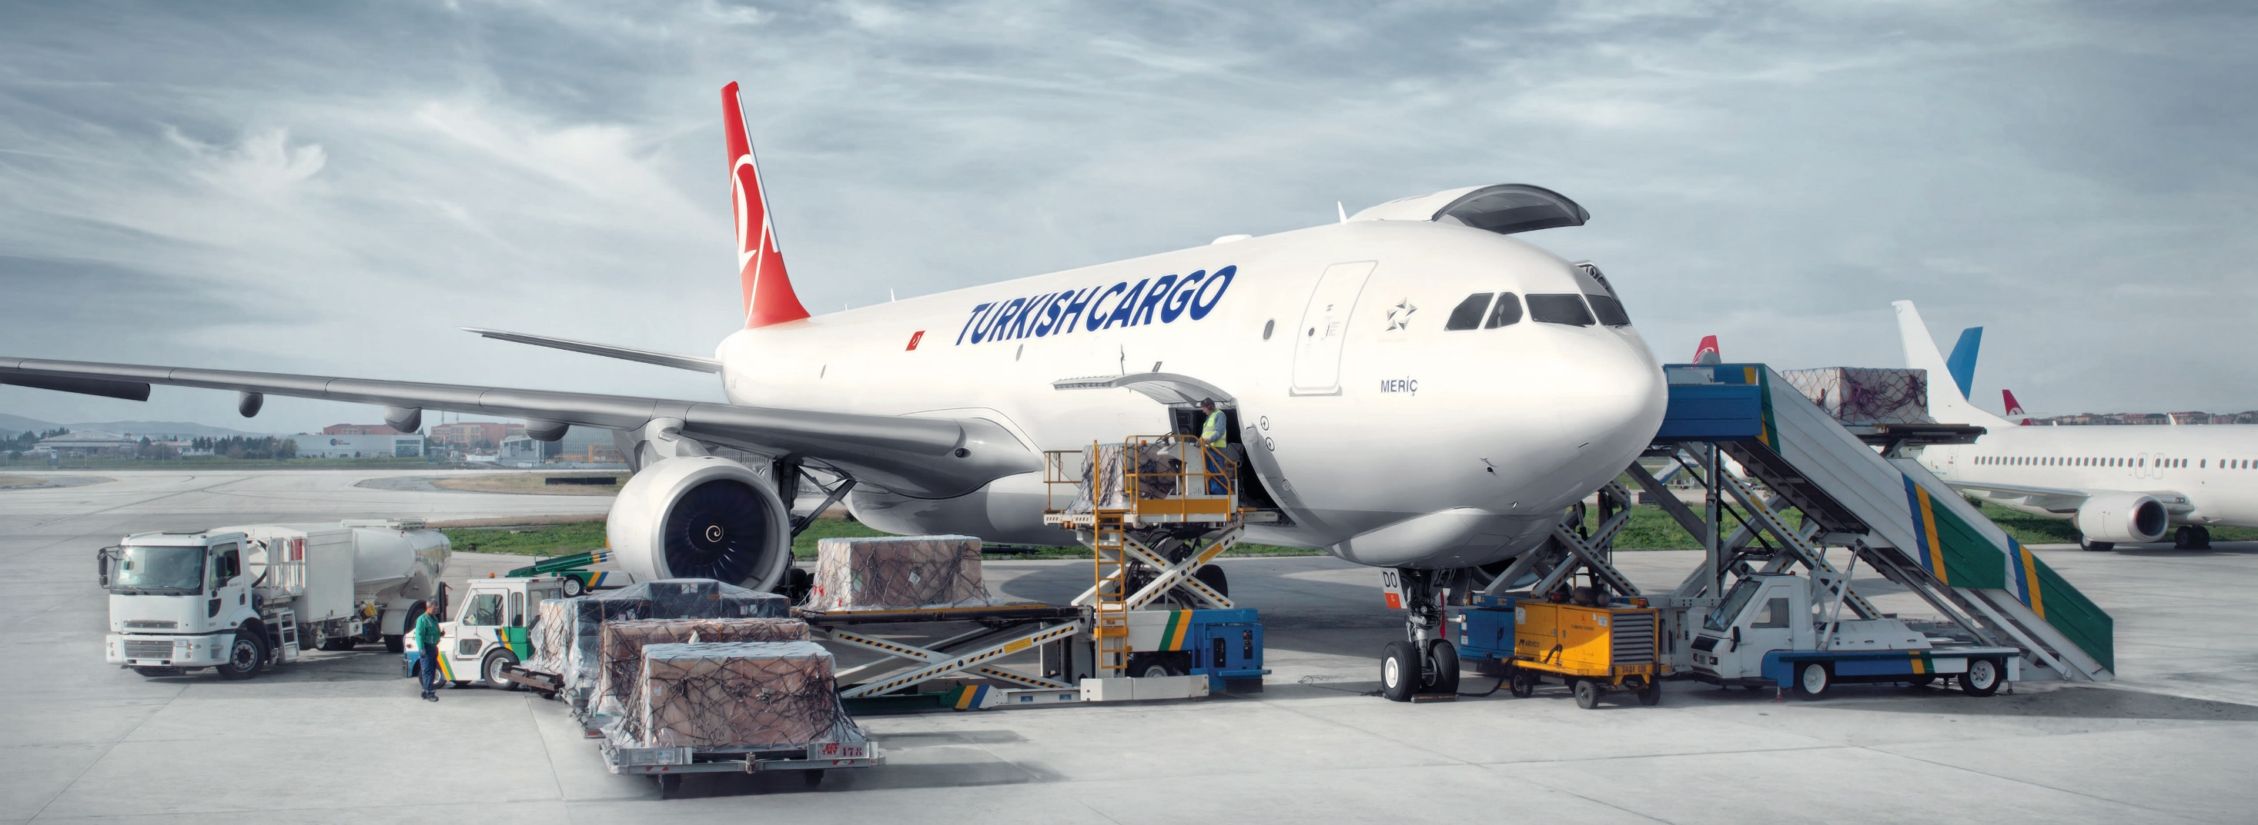
TK FRESH
Commercial Film
Notes:
Hi everyone, I welcome you on behalf of Turkish Cargo which is the fastest growing air cargo carrier in the world. We are very glad to host you here.
Firstly, let me introduce myself briefly.
And today, I’m going to make a presentation about perishable cargo transportation of Turkish Cargo.

Slide 2

Table of Contents
01
02
03
04
05
06
INTRODUCTION
NETWORK
FACILITY
INDUSTRIAL SOLUTIONS
QUALITY AND STANDARDS
FUTURE &
HOW TO IMPROVE
Definiton of Perishable Cargo
Types of Perishable Cargo
Process Map
TK Network
World Fresh Air Trade Lane – Origin Countries
World Fresh Air Trade Lane – Destination Contries
HUB Connectivity Change
Turkish Cargo HUB
IST Satellite Facility
Temperature Controlled Storage Rooms
Fact and Figures
TK Fresh Product
Active and Passive Solutions
Thermal Dolly
Actions for Quality and Standards
Our Goals and Objectives
Istanbul New Airport
Awards
Notes:
The outline of the agenda is like that:
Firstly, I’m going to explain what perishables are, types of them we mostly ship and business process of perishable products in air cargo sector. Secondly, I’ll talk about TK Network which is one of the most comprehensive network in the world. And then I’m going to give insight into our capabilities in detail. In fourth part, you will be informed of our industrial solutions using for maintenance of the cold chain. Then you will be familiar with our quality and standards processes. Finally, I will mention briefly about future plans of Turkish Cargo.

Slide 3


INTRODUCTION
01
Definition of Perishable Cargo
Types of Perishable Cargo
Process Map
Notes:
Let’s start with the introduction.

Slide 4
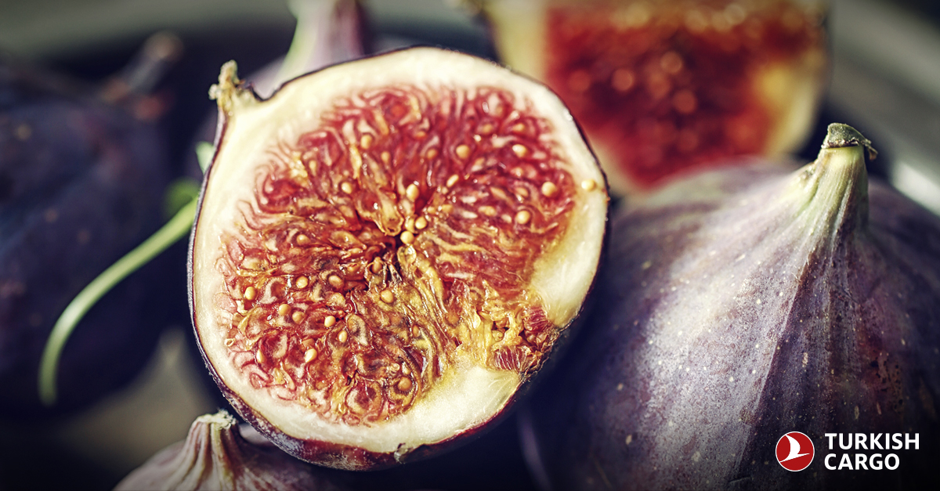
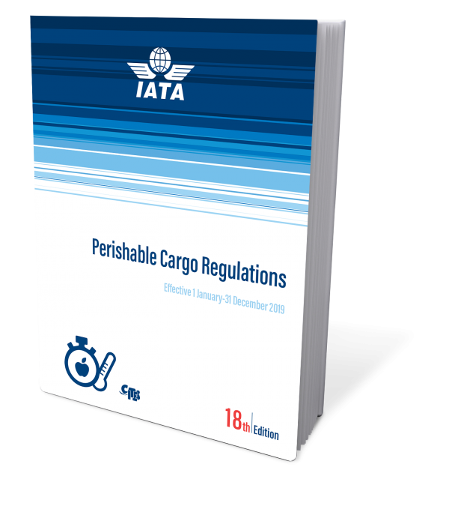
Definition of Perishable Cargo
Commodities are perishables which are sensitive to the extreme temperatures, might be spoiled without proper care and handling procedures.
Perishable goods are subject to decay, deterioration or decomposition over a period of time or if expose to adverse temperature, humidity and other environmental conditions.
Notes:
This is the basic definiton of perishable product derived by IATA. IATA Persihable Cargo Regulations is the main book we work by these guidelines.
Perishable products are so supersensitive to time and temperature that they might spoil over a period of time and when subject to adverse environmental conditions. As the airline that aims to be one of the biggest perishable carrier in the world, we have to take measures to these potential risks.
Based on our corporate objectives, perishable products are crucial in our product portfolio and that is why we have special instructions for perishable products and have huge investments in perishable product transportation.

Slide 5


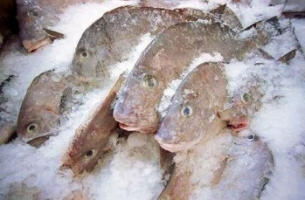
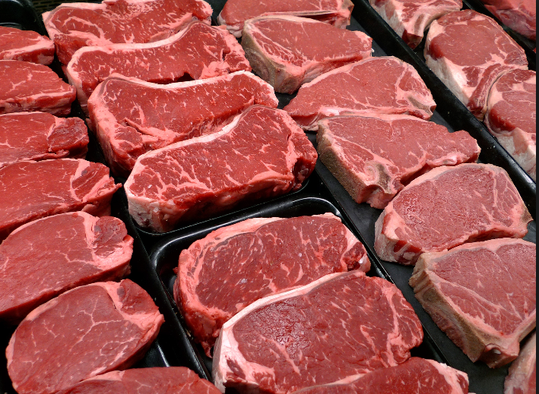
Types of Perishable Cargo
Human foodstuffs
Vegetables and fruits
Fresh/frozen meat
Fresh/frozen fish
Flowers
Plants
Eggs for human consumption
Chocolate and dairy products
Notes:
These are perishable commodities that we mostly ship. If I need to give some examples, we transport lots of flowers coming from Nairobi, Ecuador, Amsterdam, Antalya (Turkey).
As for fresh fish, we are really strong in fresh fish market, as well. We ship a lot of fishes from İzmir, Turkey, salmon from Oslo, Norway. And we ship a lot of Tuna fish from Maldivs and Colombo.
We transport fruits and vegetables all over the world and of course dairy products such as milk.

Slide 6







Process Map
Cargo Reservation
Cargo & Document Acceptance
Flight Preparation
Pre-Alert Messages - Unloading
NOTOC Form
& Loading
Notes:
This is the business process in air cargo industry. I will not go in detail beacuse I don’t want to bore you and you might be familiar with the process.
The process starts with booking. In order to start the process we would like to gather all of the required information from freight forwarders. As long as we have information in hand, we input information into our IT System (COMIS). Each stakeholder in our handling process know what is coming to IST, what is the commodity, what is the temperature zone, AWB, number of pieces etc. As a result of these, booking can be regarded as a precondition for smooth operation.
After the reservation, cargo and document acceptance process starts. Labelling and marking are very important in air cargo industry. We want to see labels and markings on the package, which indicate temperature zone and special requirements When the shipments are brought to our facility, they are examined by our certified staff and despatched to temperature controlled storage rooms in accordance with warehouse storage instructions.
In the process of flight preparation, we use industrial solutions for lean and smooth operation, I will explain later on.
NOTOC is an information form given to captain by loading supervisor, it indicates loading positions of shipments. Captain provides appropriate condition for shipments in the compartment according to NOTOC.
After the take off, we send pre alert messages to final destination and so that our local personals have enough time to make preparation.

Slide 7
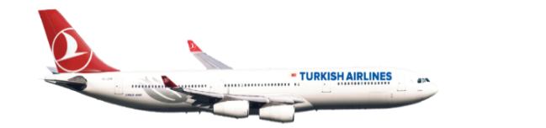
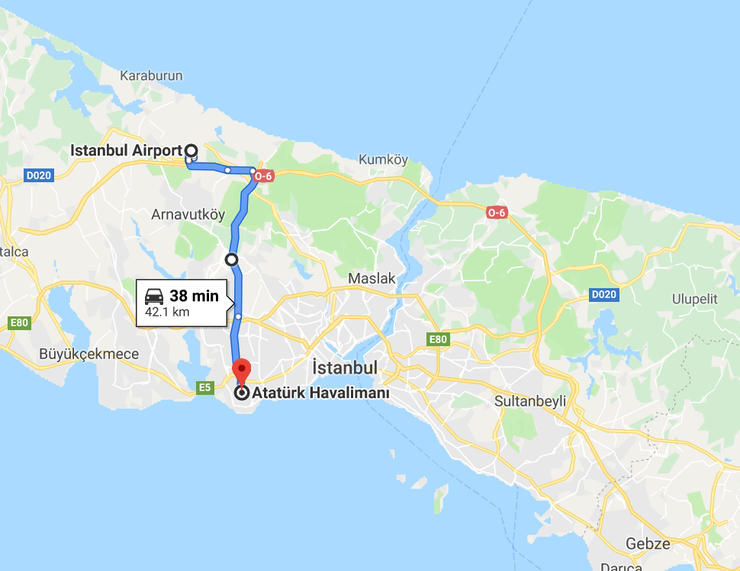
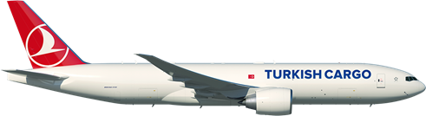
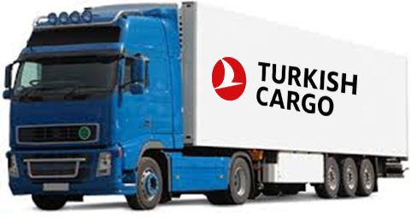
Dual Hub Operation
Origin
Truck Operation Between IST and ISL
IST
10 dedicated temperature controlled and calibrated vehicles
ADR certified trucks for dangerous goods
Dedicated lead packing truck for radioactives
42 km
ISL

Slide 8

NETWORK
02
TK Network
HUB Connectivity Ranking
World Fresh Air Trade Lane – Origin Countries
World Fresh Air Trade Lane – Destination Countries
Notes:
In this section, you will see one of the most comprehensive network in the world.

Slide 9
TK Network
MORE COUNTRIES THAN ANY OTHER AIRLINE IN THE WORLD
126
COUNTRIES
MORE INTERNATIONAL DESTINATIONS
THAN ANY OTHER IN THE WORLD
263
INTERNATIONAL DESTINATIONS
4TH LARGEST NETWORK
IN THE WORLD
315
POINTS
1.
1.
4.
Notes:
With the goal of having the youngest and most modern fleet in Europe, we are proud to acquire our 338th airplane. 23 freighther
As the airline that flies to more countries than other carriers in the world, it is one of our corporate mission is to transport perishables, time and temperature critic products, to wherever they are needed in the world in order people to feel happy.
We have extensive network by means of over three hundreds passenger aircrafts and 23 freighter aircrafts.
We are number one in terms of country. Well, we fly more countries than any other airline. We are also number one in international destinations. In addition, we are number four when we consider domestic destinations with international destinations.

Slide 10
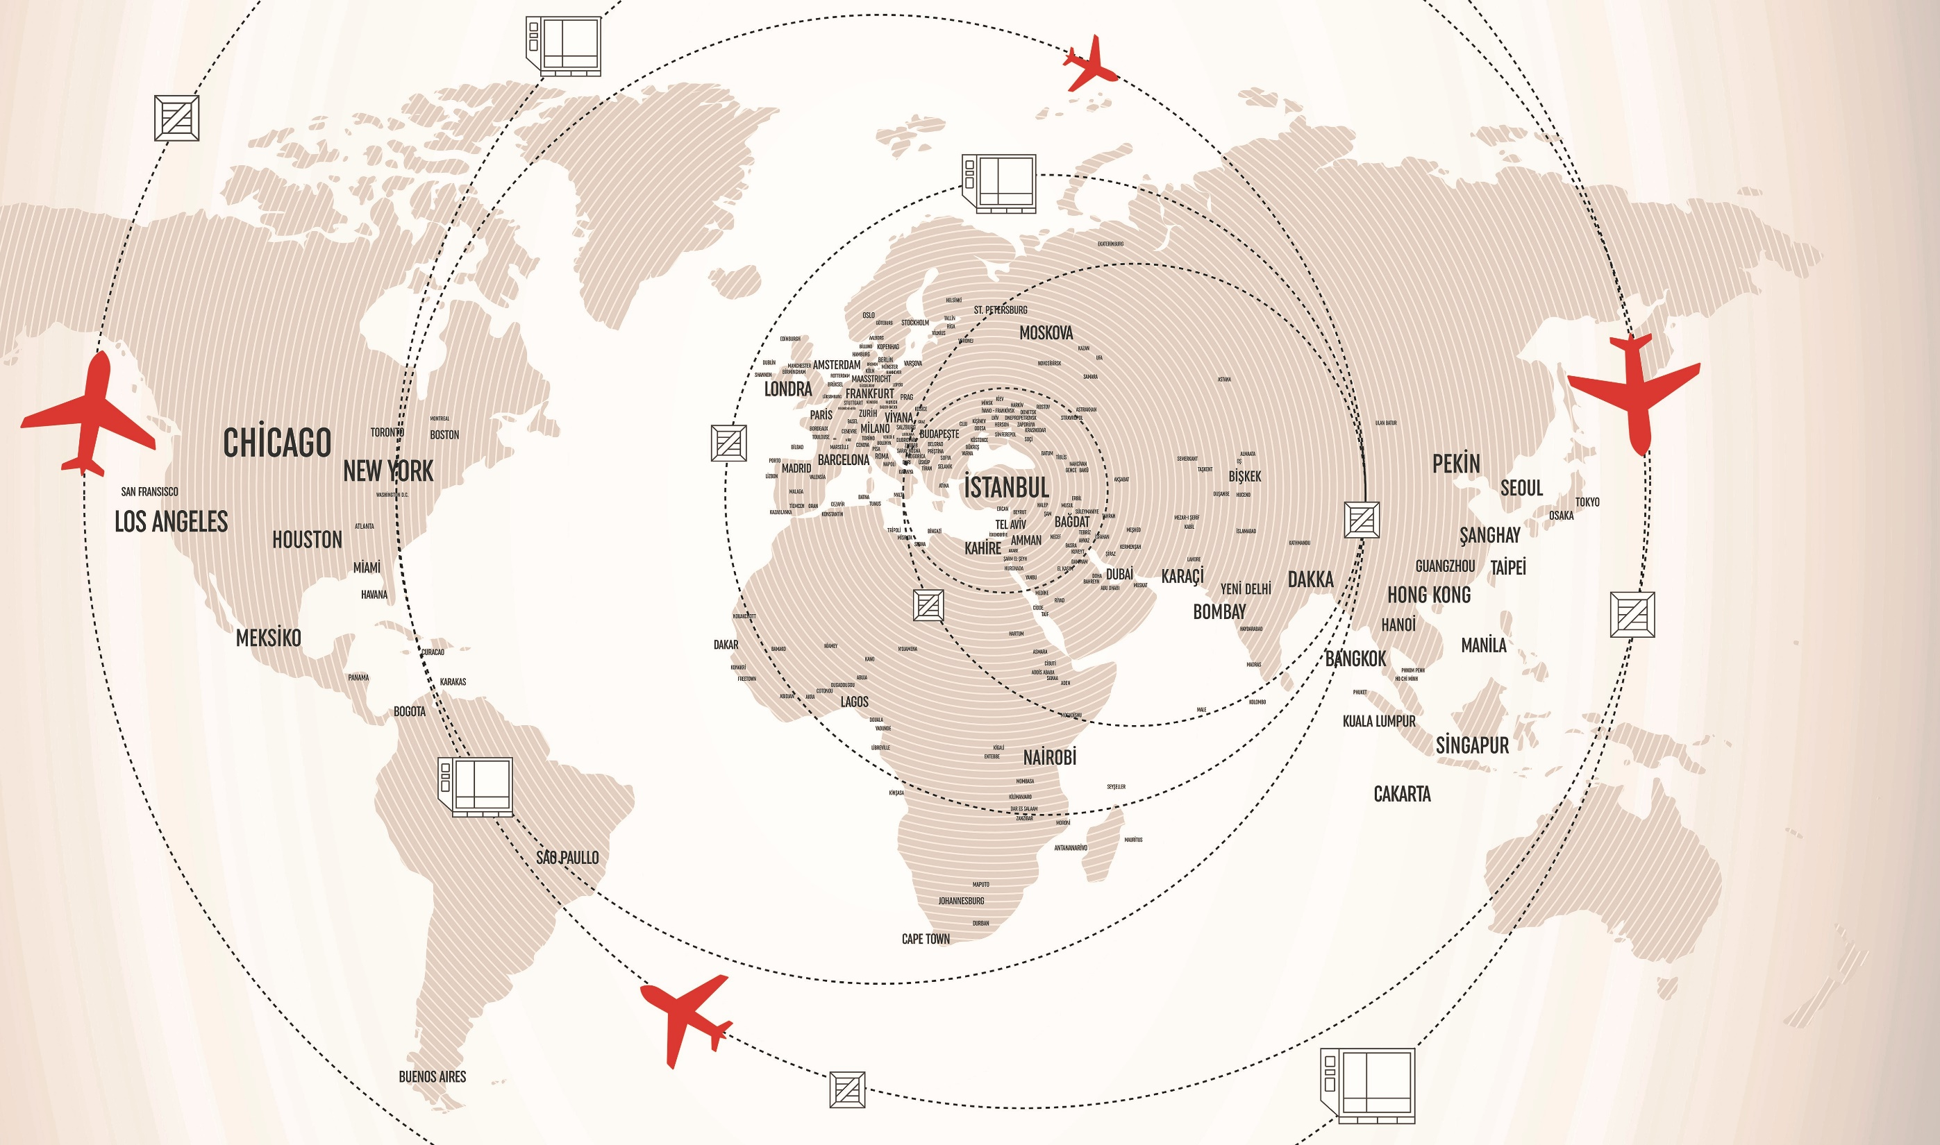

Turkish Airlines Passenger Aircraft Network
NORTH
AMERICA
EUROPE
114
52
58
13
6
37
35
MESA
FAR EAST
AFRICA
 | Country | City | Station
Europe | 42 | 113 | 114
Africa | 38 | 58 | 58
Far East | 22 | 37 | 37
Middle East | 14 | 35 | 35
America | 9 | 19 | 19
Domestic | 1 | 49 | 52
Total | 126 | 311 | 315
SOUTH
AMERICA
SOUTH AMERICA
Pax Fleet (WB) : 94
Pax Fleet (NB) : 203
Notes:
Turkish Airlines flies to most countries than any other airline. Here you see the pax destinations.
Our plan is to widen our network from 315 destinations to 350 in the following 4 years.

Slide 11
Turkish Airlines Cargo Aircraft Network
NORTH
AMERICA
EUROPE
28
FAR EAST
15
6
3
19
13
2
MESA
AFRICA
 | Country | City | Station
Europe | 24 | 28 | 28
Africa | 15 | 15 | 15
Far East | 13 | 19 | 19
Middle East | 11 | 13 | 13
America | 6 | 9 | 9
Domestic | 1 | 2 | 2
Total | 70 | 86 | 86
SOUTH
AMERICA
Freighter Fleet (WB) : 23
Notes:
We are heavily investing on our freighter network as well. Our freighter fleet consists of 23 pure freighters and our cargo network reached 88 destinations worldwide. Our aim is to reachh 120 cargo destinations in 2023.

Slide 12
HUB Connectivity Ranking
HUB CONNECTIVITY DEVELOPMENT
4th
Airport Connectivity in Europe
624%
IST has the fastest increase regarding connectivity among the European Hubs by 624%.
Source: ACI Europe Airport Industry Connectivity Report, 2017
Notes:
This is a table indicating hub connectivity development in Europe airports. When we look into IST we see that there is a big change between 2010 and 2017. IST gone up from thirteenth to fourth in seven years.
According to a research of IATA, center of air cargo trade is somewhere on Mediterranean Sea, today. As you know, Asia has been growing in terms of trade and in 2023 the center of air cargo will be a point in Black Sea which is 150 kilometers far from İstanbul. It means that the importance of İstanbul will increase and also importance of Turkish Cargo.

Slide 13
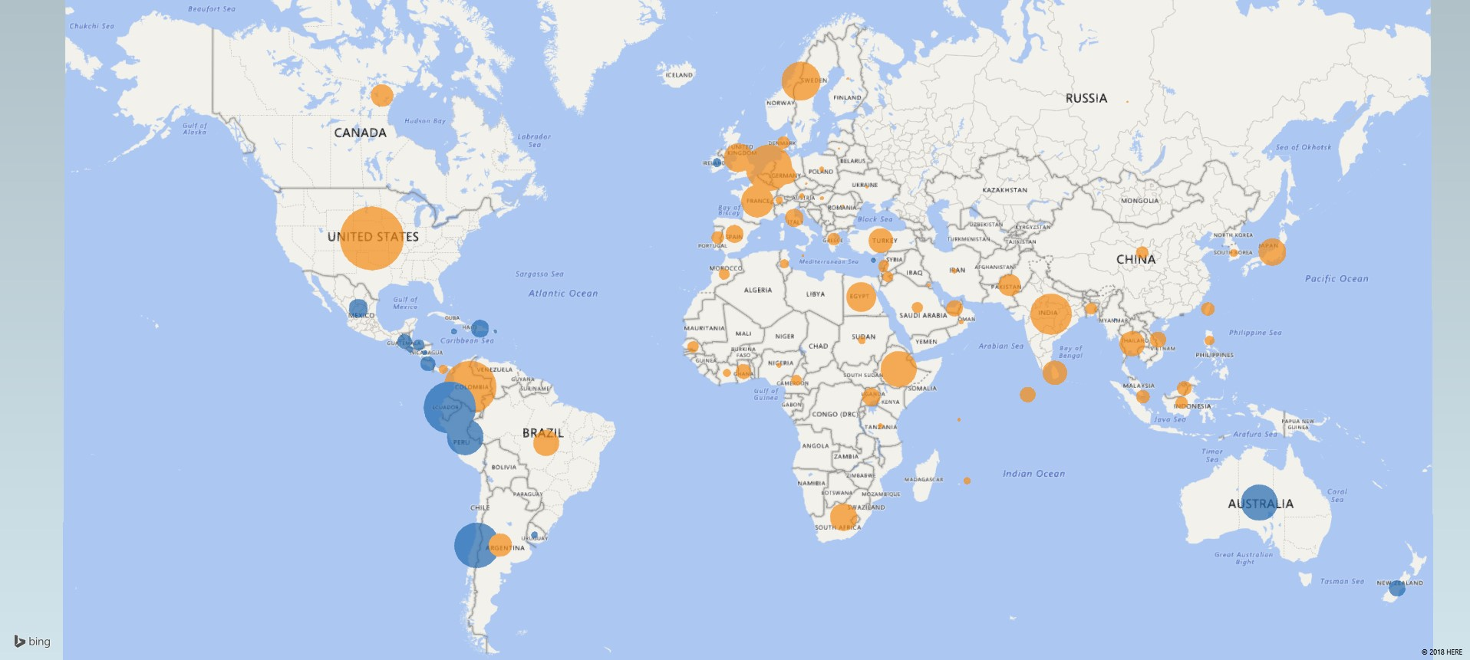















World Perishable Air Trade Lane – Origin Country
82% of
Volume of Origin Countries
TK Coverage
WACD
Not in TK Coverage
Notes:
These bubbles are the perishable products generating markets. The size of each bubble represents the size of the market, meaning that the larger bubble the bigger share in perishable market.
In the first instance; US, Western Europe, African countries, Columbia and India takes attention.
The majority of origin stations already fulfills the requirements for a smooth perishable cargo operation.
We see higher technological investments in those origin countries such as US, India, and European countries when compared to countries in Africa and Middle East.
In terms of origin countries, %82 of the volume (Chargable weight) in our network coverage.

Slide 14
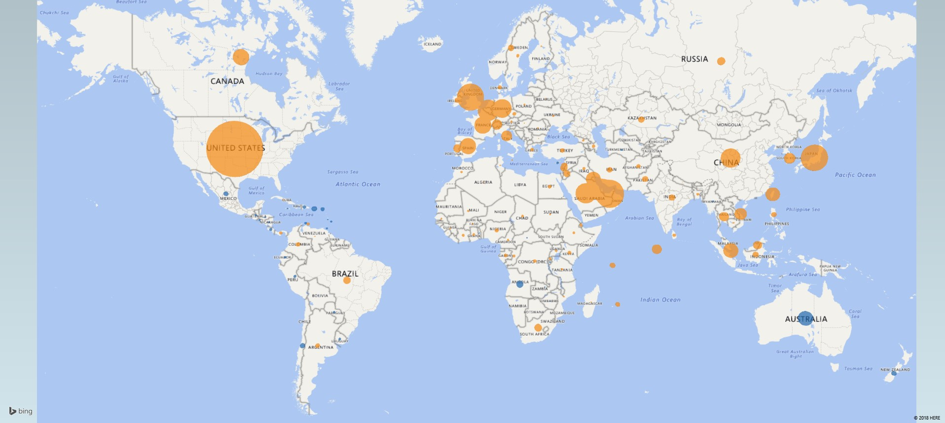


World Perishable Air Trade Lane – Destination Country
86% of
Volume of Destination Countries
TK Coverage
Not in TK Coverage
WACD
Notes:
On the other hand, these bubbles are representing the perishable (importer) consumer markets. US, Europe, Middle East and Japan takes attention.
Another important point:
From the destination perspective, %75 of the volume (Chargable weight) has been covered by TK Network.

Slide 15
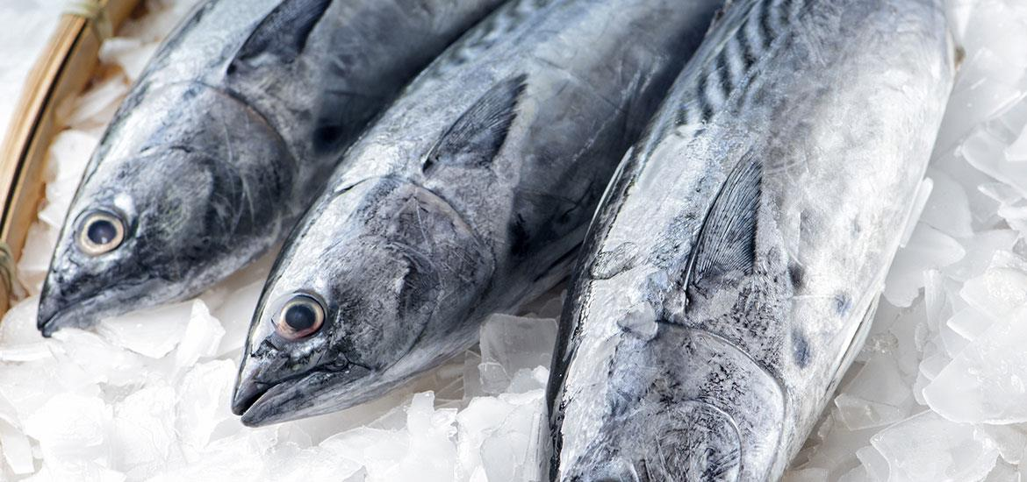
FACILITY
03
Turkish Cargo HUB
IST Satellite Facility
Temperature Controlled Storage Rooms
Fact and Figures

Slide 16
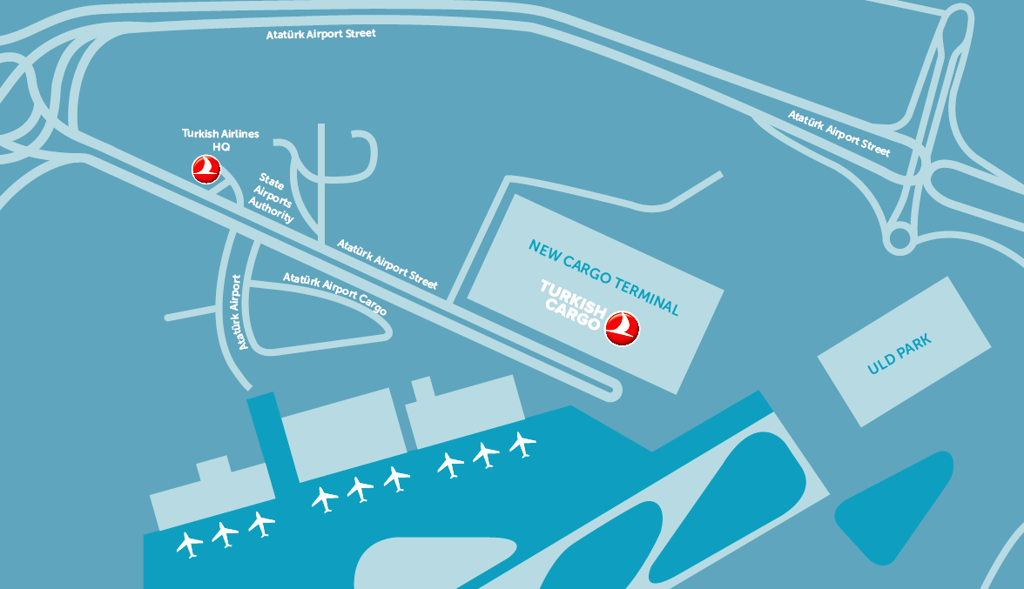
Turkish Cargo HUB
1.2 MILLION TONNES
Annual
Tonnage
Capacity
43.000 m²
Closed Warehouse Area
67.000 m²
Total Construction Area
71.000 m²
Total Floor Area Used
(Land and Air Side)
  Cold storage: 0°C/+4°C
  Cold storage: +2°C/+8°C
  Cool storage: +15°C/+25°C
  Frozen storage: -15°C/-20°C
Notes:
This facility has come into service in the beginning of 2015 with the aim of service at high standards.
In terms of tonnage, our annual capacity is 1.2 million tons. The facility is 70 thousands square meters and 3700 square meters belongs to special cargoes.
We have bigger and proper operation area, higher volume in storage area, complex and higher quality security system, acceleration in cargo admission and operational processes. And I think the most important point is that we have dedicated storage rooms for all kinds of products. In other words, we don’t store your perishable goods with other products together.
We have storage capability between -20 and + 25 degrees.

Slide 17
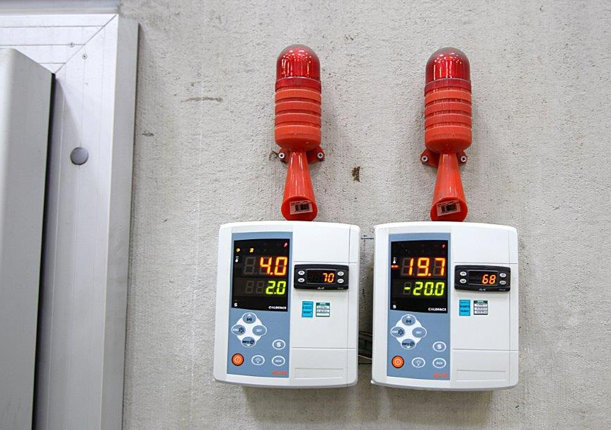
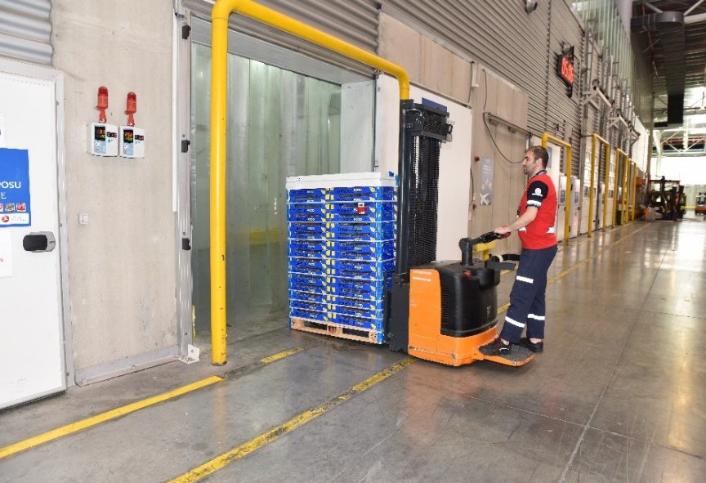
Temperature Controlled Storage Rooms
Temperature controlled storages:
  Cold storage: 0°C/+4°C total 549m² 7 rooms
  Cold storage: +2°C/+8°C total 879m² 9 rooms
  Cool storage: +15°C/+25°C total 861m² 9 rooms
  Frozen storage: -15°C/-20°C total 393m² 5 rooms
Capability of remote temperature and humidity tracking using smart sensors
Ability to report the shipments stored within time range at specific cool storage
Safe and secure locking system and automatic alert system
Notes:
We have totally 41 sepacial cargo rooms and 30 of them is temperature controlled rooms.
We have temperature and humidity sensors in all storage rooms. These sensors intercommunicate with Telemetry System which is used for remote monitoring. We can instantly monitor temperature and humidity through Telemetry System.
All around the facility we have audible and visual alarm system which run in case of any irregularity.
We have special cargo care team working in the warehouse. They make sure your shipment in the correct temperature controlled room.

Slide 18
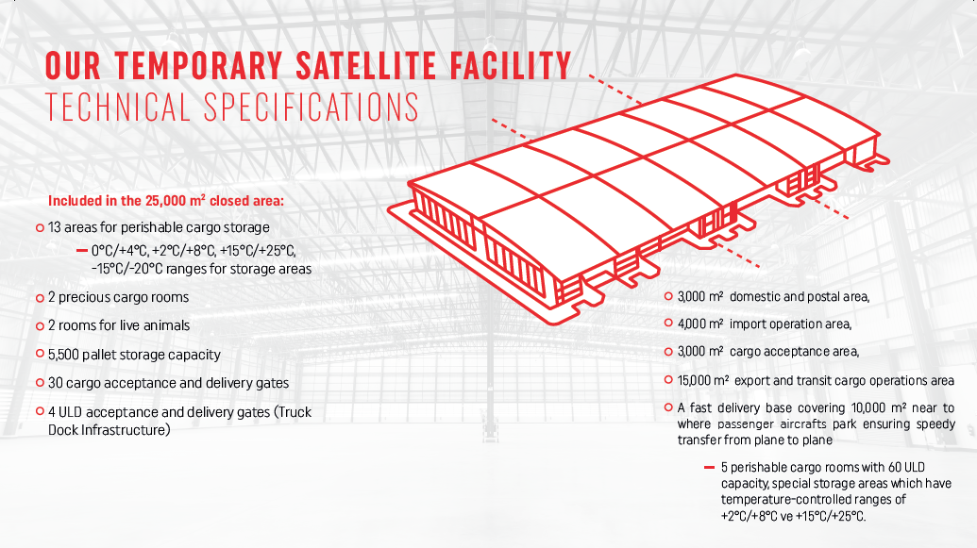
İstanbul Airport – Satellite Facility
valuable
valuable
Notes:
We have satellite facility in IST airport which has been using till the completion of Mega HUB. Temporary facility is twenty five thousand sqm which has all capabilities we have in ISL airport.

Slide 19
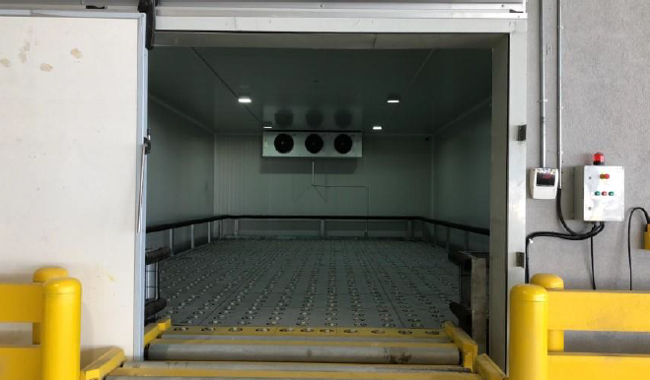
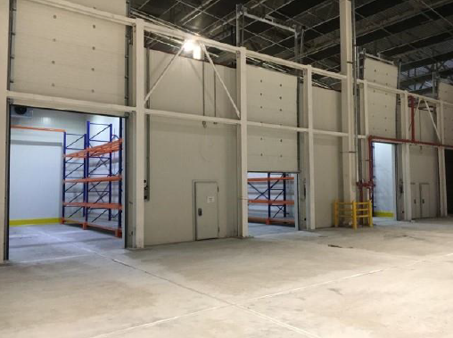
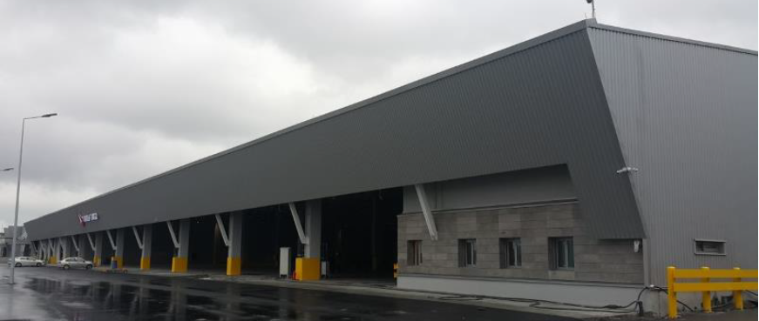
Satellite Facility – Special Cargo Storage Rooms
Temperature Controlled Storage Rooms:
  Cold storage: 0°C/+4°C total 259 m² 4 rooms
  Cold storage : +2°C/+8°C total 288 m² 4 rooms
  Cool storage : +15°C/+25°C total 229 m² 3 rooms
  Frozen storage : -15°C/-20°C total 117 m² 2 rooms
2 rooms total 138 m² dedicated live animal waiting & care room (18°C – 26°C)
2 rooms total 130 m² valuable Cargo storage rooms
Notes:
13 temperature controlled storage room at wide temperature range.

Slide 20
Satellite Facility
Total of 60 minutes in tarmac for transit shipments
From Aircraft to W/H : 30 minutes
From W/H to Aircraft: 30 minutes

Slide 21
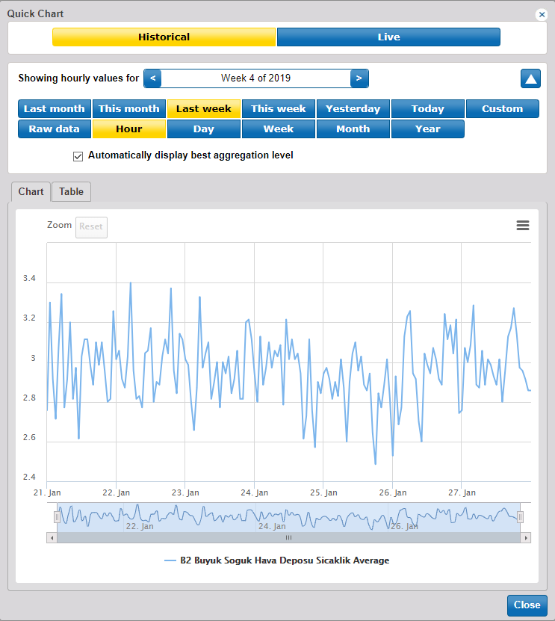
Temperature Controlled Storage Rooms
Telemetry System
Temperature and humidity values of cold chain storage areas and facilities is monitored through automated system called Telemetry
The cold rooms can be monitored instantly, and temperature and humidity values can be reported retrospectively
Notes:
And this is an IT system called Telemetry System. Our storage rooms are monitored instantly and the system automotically send messages in case of any temperature deviation and we take action immediately. Through telemetry system retroactively report is also possible.

Slide 22
Facts & Figures
Cargo Development & Special Cargo Ratio
7th
Largest Cargo
Carrier in the World
Operates to 86 destinations with 23 freighters
Totally 315 destinations with 344 aircrafts (321 passenger aircrafts and 23 freighters)
Forecast
TOTAL CARGO (Thousand Tons)
Special Cargo Share in Total
TOTAL CARGO (Thousand Tons)
Notes:
But, how we achieved these continuous growth rates, becoming one of the fastest growing cargo carriers in the world by more than 20% on average within the last decade.
Our growth did not stop while cargo volumes grew by 4.1% to 63.7m tons in 2018 and the industry forecast suggest that will then slow to 3.7% to 65.9m tons in 2019, according to IATA.
So how could we go so far in time critical products?
Behind this sucess, lies the corporate organisation, blue and white collar employees

Slide 23
Facts and Figures
Source: World Air Cargo Data

Slide 24

INDUSTRIAL SOLUTIONS
04
Features of TK Fresh Product & Service
Active and Passive Solutions
Thermal Dolly
Notes:
We have dedicated industrial solutions in order to protect cold chain against several risks.

Slide 25
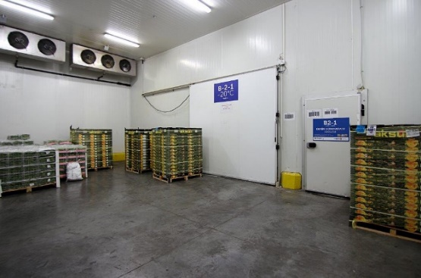
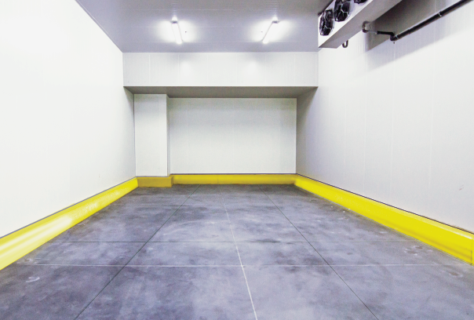
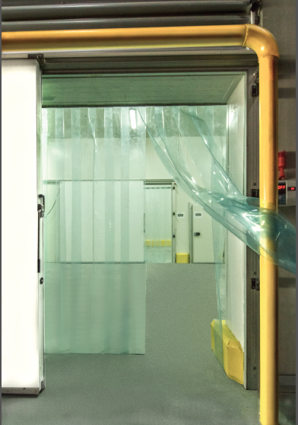
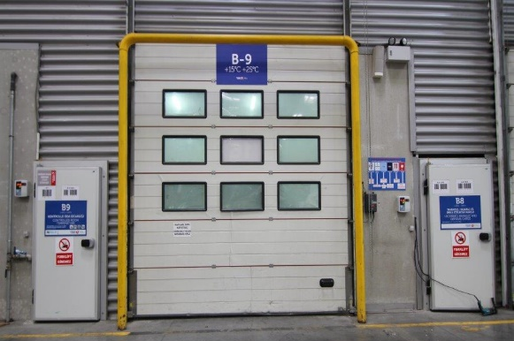
Features of TK Fresh Product
More than 104.000 tons of annual perishable shipments in 2018
Experienced in Perishable Cargo shipments for more than 30 years
Prioritized acceptance gate for perishable shipments
Prioritized loading & unloading
Reliable transportation in accordance with IATA Perishable Cargo Regulations
Easy and faster online booking availability
Temperature controlled trucking service for perishables
Thermal Blankets option available
Fresh Fish and Fruits & Vegetables specialized
Can be combined with TK Plus service for urgent PER shipments
Active container option available upon request
Notes:
TK Fresh product has advantages in many respects. TK Fresh has priority over general cargo from the cargo and document acceptance to storage.
As the airline that flies to more countries we are also higly experienced in perishable trasnportation: 30 years experience.
Perishable goods operations are carried out in accordance with IATA PCR.
TK Fresh offers priority acceptance gate and priority loading/unloading. Easy and faster online booking and temperature controlled trucking service is available.
We have Special Cargo Perishable Care Team who make sure your shipments is stored in correct temperature zone and whether there is an irregularity with shipments
TK Fresh can be combined with TK Plus service which give capacity guarantee and has money back guarantee.

Slide 26
Active & Passive Solutions
TK Solutions
Active Solutions
Passive Solutions
Envirotainer
Single use thermal blankets
C-Safe
Dokasch-TS
Notes:
We have active and passive solutions in order to prevent the occurrence of temperature deviation.
We use thermal blankets as passive solutions in order to protect perishable products from exposure to adverse temperature. Thermal blankets do not keep constant temperature. However, they slow down temperature changing.
Apart from passive solutions, we have active solutions as well. We work with Envirotainer, Dokasch and Csafe. Also we are in negotiation process with other container companies and we will add them in our product portfolio as soon as possible.

Slide 27
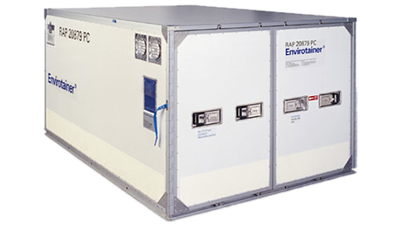
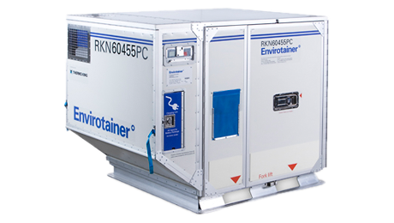
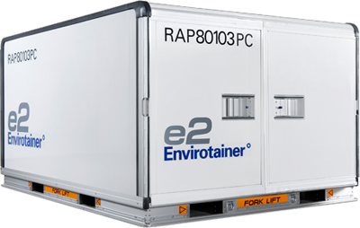
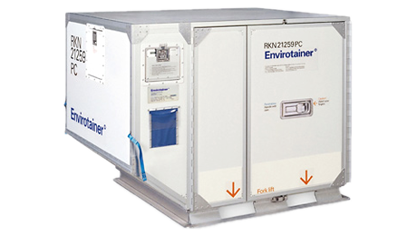
Active Temperature Controlled Containers
To prevent our cargoes from being exposed to often changing temperatures during flights, we use Envirotainer active Temperature controlled containers and we maintain constant and desired temperature throughout the entire cold chain even to long-distance destinations.
Thanks to our agreements we’ve made with international container supplier Envirotainer, we can realize shipments between -20°C and +25°C at the demanded circumstance and capacity.
Notes:
As active industrial solutions, we work with Envirotainer, Dokasch and Csafe. Apart from these companies, we are under negotiation process with Vaqtech, Skycel.
We use active temperature controlled containers to prevent temperature sensitive shipments from exposure to temperature deviation and adverse environmental conditions.
We provide container for our customers in accordance with requirements and send them to stations where they are needed.

Slide 28
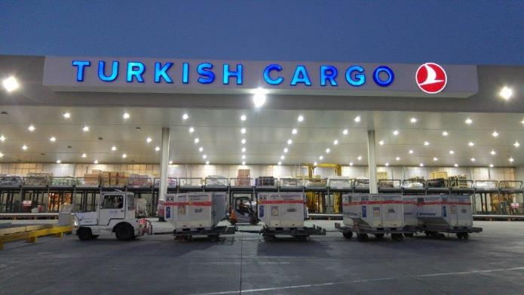
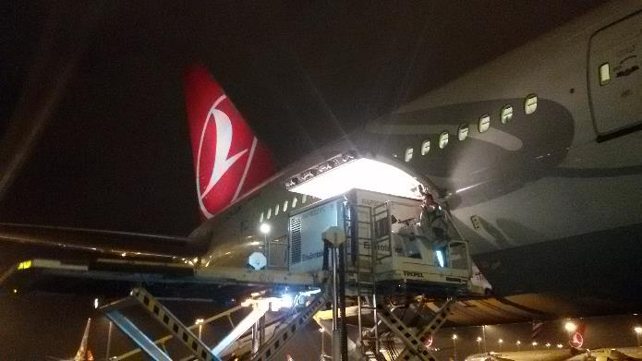
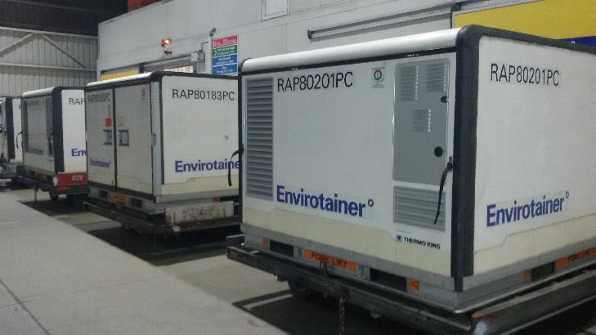
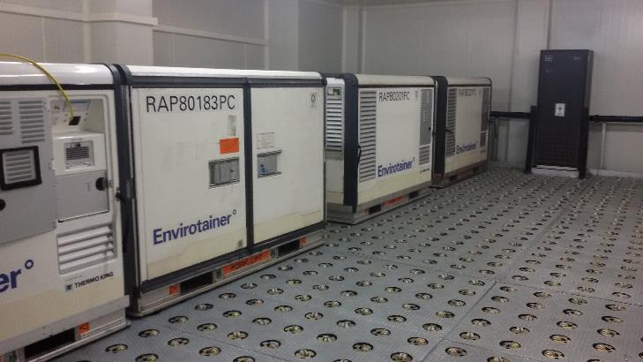
Active Container Transport

Slide 29
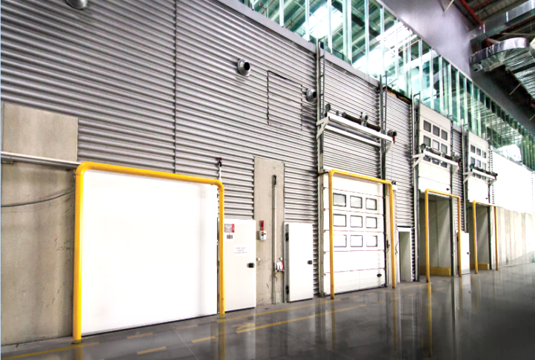
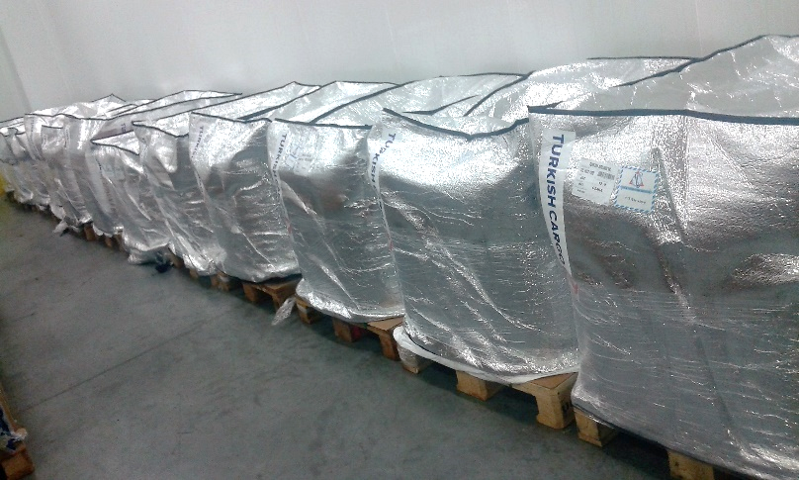
Single Use Thermal Blankets
The single use thermal covers are used for protecting perishable products from external environment.
Single use thermal covers do not keep constant temperature. Covers slow down the increase or decrease of temperature.
Notes:
We use also thermal blankets as passive solutions in order to protect pharmaceuitcal products from exposure to adverse temperature.
Even though thermal blankets do not keep temperature constant, they slow down temperature changing.

Slide 30
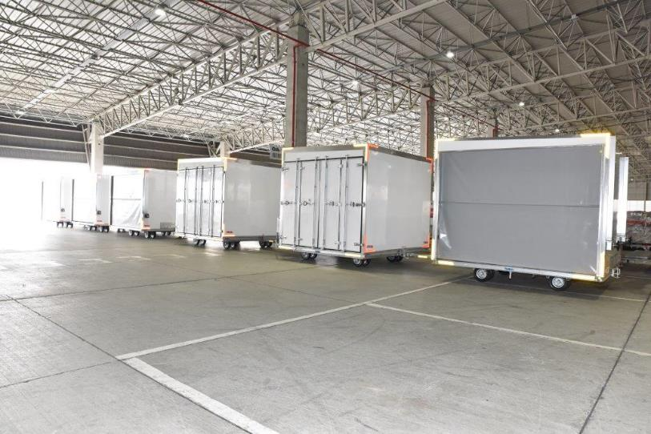
Thermal Dolly
Thermal Dolly is an active temperature controlled dolly used for the transportation of temperature sensitive cargo in between temperature controlled rooms and aircraft.
Thermal Dolly is also used for the temporary storage of temperature sensitive cargo for short connections (1-4 hrs).
Total number of Thermal Dolly available is 6.
Maximum Load Capacity: 7.000 kg
Adjustable Temperature Range: -20 / +20 ◦C
1 PAG / PMC or 2 AKE / AKH
L x W x H : 318 x 244 x 240 cm
Notes:
Furthermore, we use thermal dollies on request. They are temperature controlled dolly and used for transportation of products between storage rooms and aircraft, also for temporary storage of temperature sensitive cargo with short connection time.

Slide 31
  IST Hub – Healthcare Transportation Tarmac Process
Last in First out procedure (LIFO)
Prioritized loading & unloading
Average temperatures are between 15 °C to 25 °C in the W/H
Dedicated temperature controlled rooms ( 2/8 °C , 15/25 °C , -20 °C )
Total of 45 minutes lead time on tarmac
Special SOP for time and temperature sensitive perishable products.
From Aircraft to W/H : 45 minutes
From W/H to Aircraft: 45 minutes
Check-in process time in W/H: 15 minutes
Transport to Transfer Line: 15 minutes
From Check-in area to Temperature Controlled Area : 15 minutes
Check-out process time in the W/H: 15 minutes
From Temperature Controlled Area to chek-out area: 15 minutes
Notes:
We apply LAST IN FIRST OUT procedure for perishables. We load to aircraft last and unload from aircraft first.
We take perishable goods from temperature controlled rooms as late as possible.
Average tarmac time is 2 hours prior to departure time.

Slide 32
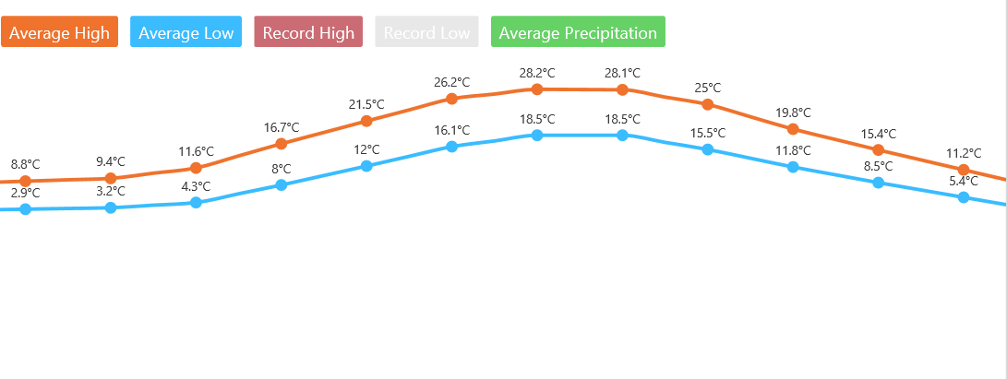
Temperature Advantage of İstanbul
Jan Feb Mar Apr May Jun Jul Aug Sep Oct Nov Dec
Notes:
As you remember I have mentioned location advantage of İstanbul. İstanbul is ahead of the game climatologically. Annual average temperature is 18 degree in İstanbul. It can be said that İstanbul, as a transfer point, is more proper, acceptable for temperature sensitive cargoes compared to rivals.

Slide 33

QUALITY AND STANDARDS
05
References CEIV
Service Provider Assessment COMIS
Audit Mapping for Temperature and Humidity
Training Capability Matrix
Notes:
As the airline that aims to be one of the biggest perishable carrier in the worl, we attach great importance to quality and standards.
Turkish Cargo has special instructions by product type.

Slide 34
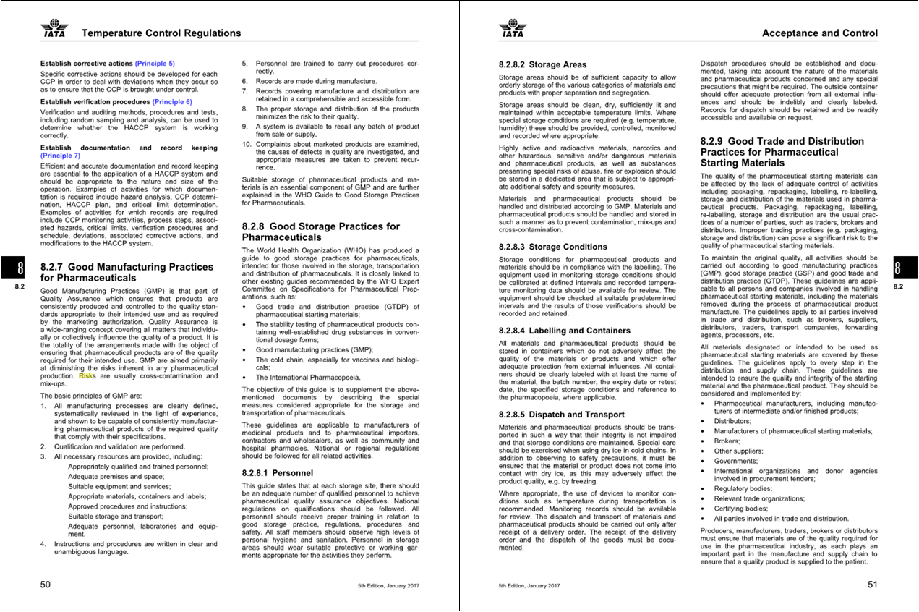

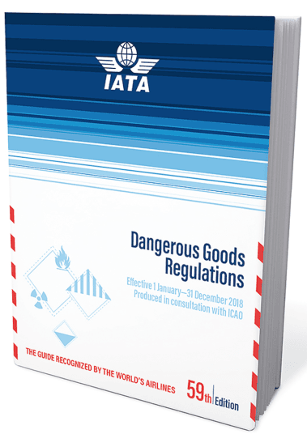
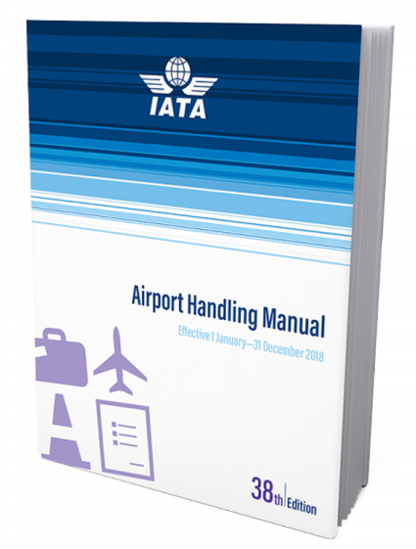
Key References for setting our Standarts and Regulations
  IATA – Perishable Cargo Regulations
  IATA – Dangerous Goods Regulations
  IATA TACT Rules Manual
  IATA Airport Handling Manual
  Local Regulations
Notes:
We take these regulations as references in our all handling process and in preparing of instructions.

Slide 35
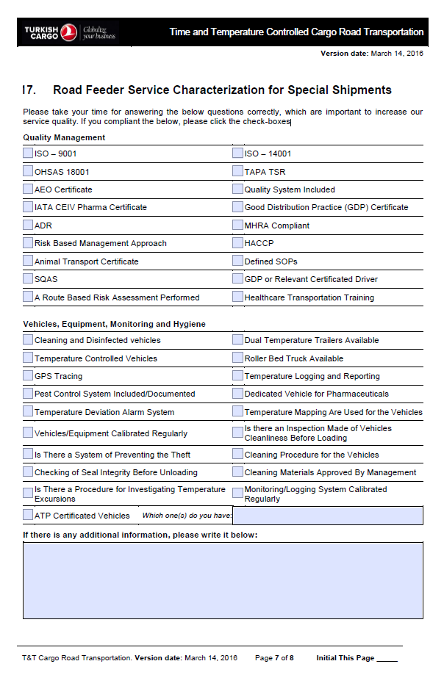
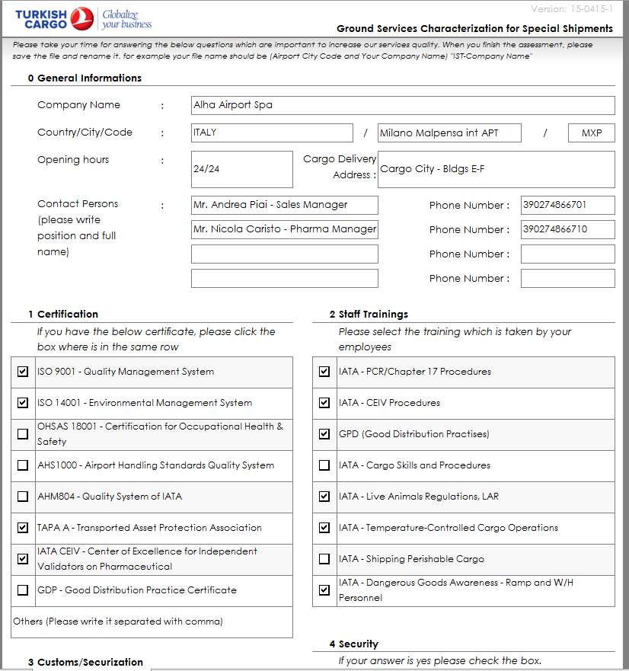
Service Provider Assessment (GHA & Road Feeder)
Service Characterization not only for our current GHA partners but also for road feeder service providers are implemented to collect and evaluate Lane Assessments for Time and Temperature controlled cargo from origin to destination.
Illustrated ONLY
Illustrated ONLY
Illustrated ONLY
Illustrated ONLY
Illustrated ONLY
Illustrated ONLY
Notes:
As Turkish Cargo offers service to you, we have service providers such as GHA and trucking companies. We evaluate handling companies, road feeders whether they are able to handle perishable products. Their capabilities is essential for us. Their failures is our failure in the eyes of our customers and their operation without any problem means Turkish Cargo has a smooth operation.

Slide 36
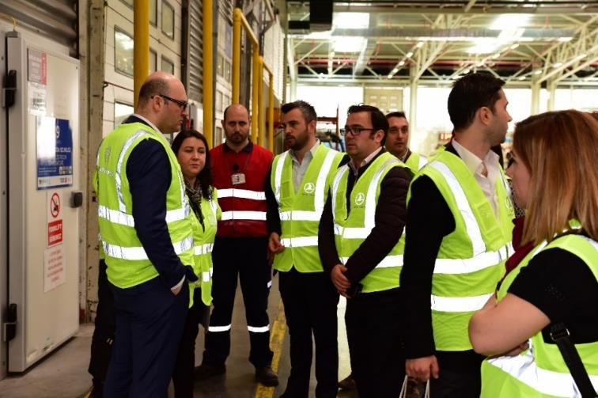
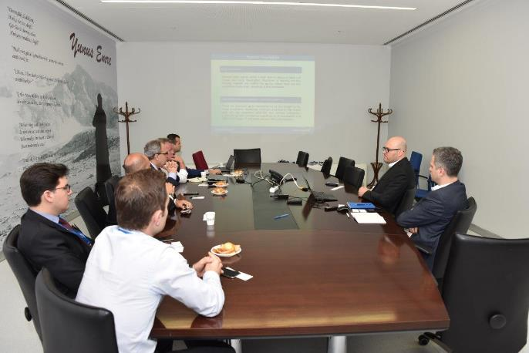
Internal and External Audits
Internal and external audits are made to measure the quality standards of perishable shipments.
Notes:
We are audited by independent auditors, forwarders, agents, shippers and quality department of TK. Station and product based inspections are also conducted.

Slide 37

Personel Training
Updating role definition of responsible person and assigning an authorised responsible person
Accomplishing required trainings for the key, competent and critical personnels
  Audit, Quality and Risk Management for Temperature Controlled Cargo
  Temperature-Controlled Cargo Operations
  Temperature-Controlled Container Operations (optional)
Updating Turkish Aviation Academy curriculum by integrating Perishable training to current on the job training programme.
Implementing online trainings in order to create personel awareness
Notes:
Our personnel get strict trainings from Turkish Aviation Academy and IATA.

Slide 38

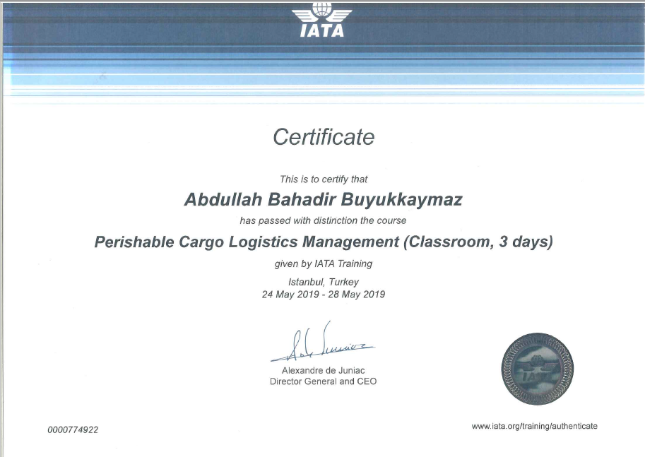

IATA CEIV FRESH and Certification
The demand for transportation of perishable on air increases considerably.
One of the most important point of perishable cargo transportation is time and temperature management to maintain cold chain.
IATA has launched a new certificate program against lack of standardized procedures and best practises.
IATA CEIV Fresh program provides organizations with the oppourtunity to become a center of excellence for perishable cargo logistics.
Turkish Cargo is in the process of IATA CEIV Fresh.

Slide 39
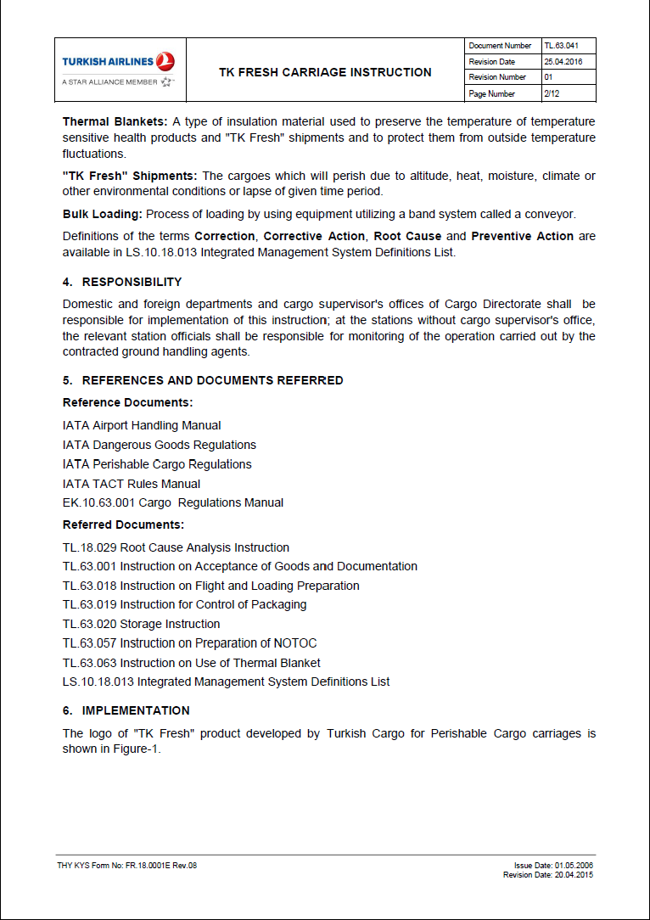
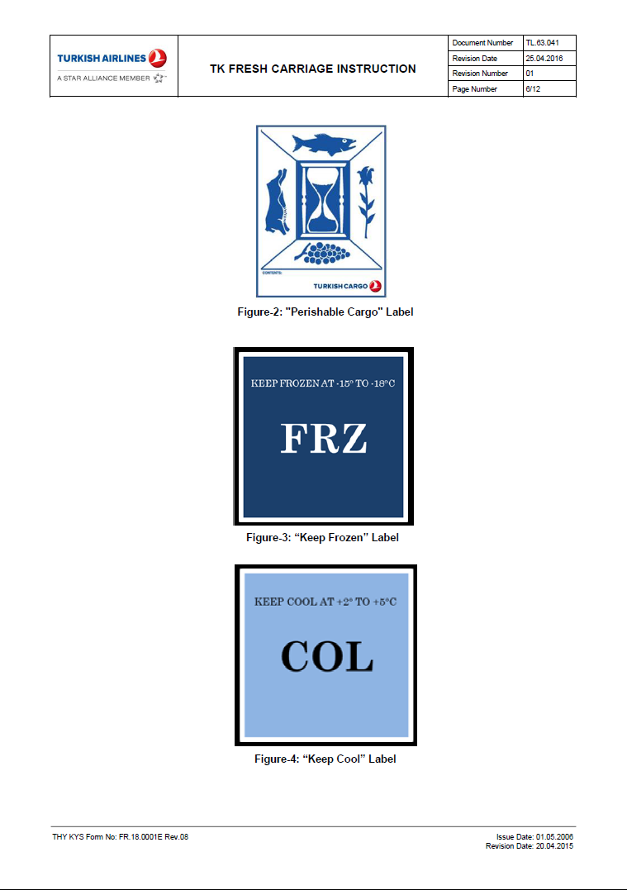
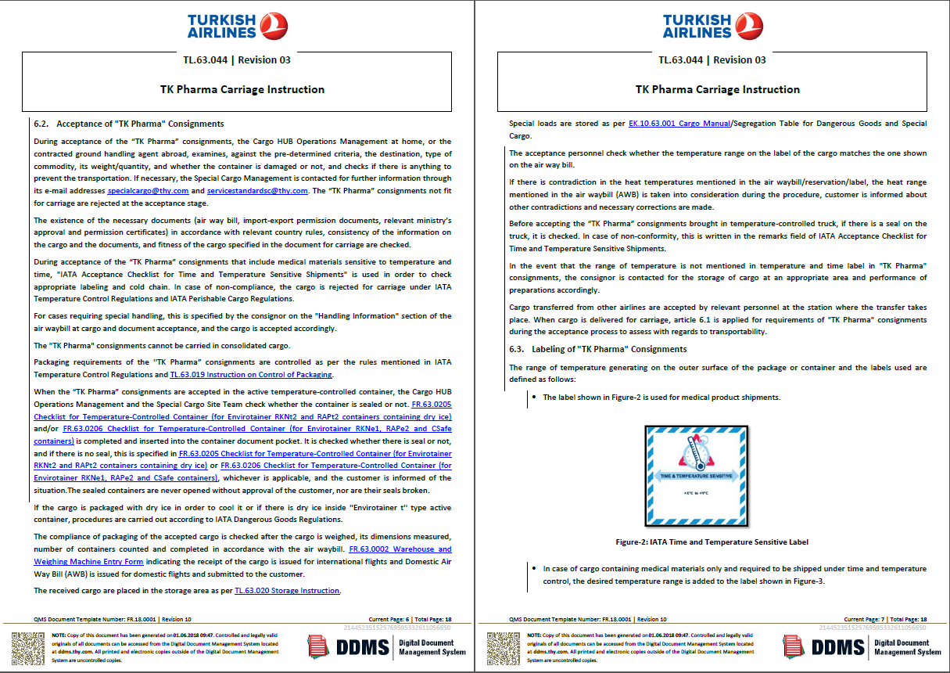
Our TK Fresh Transportation Procedures Manual
Revision on Cargo Operations Manual
Updating training documents in accordance with GDP and PCR standards
Notes:
TK Fresh Instruction and training documents are updated at GDP and

Slide 40
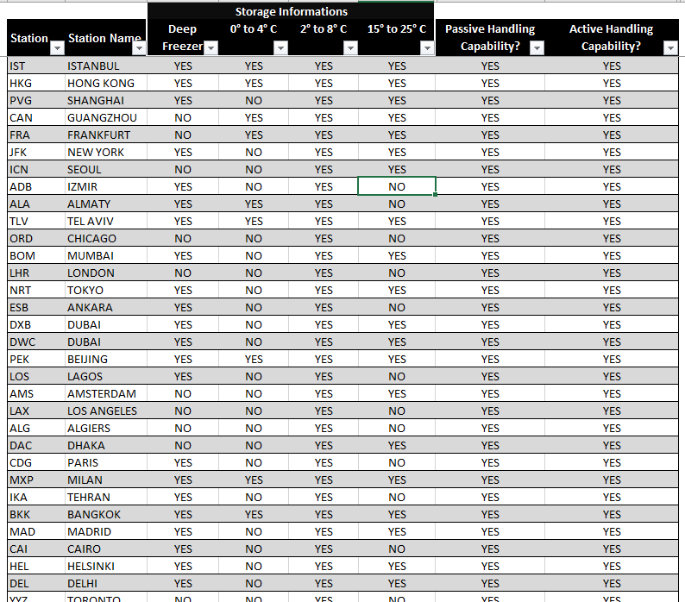
Capability Matrix
Measuring station capabilities for risk assessment
Evaluating the qualifications of trucking companies and measuring transportation distances
Notes:
This is a Matrix indicating our station capabilities. You can see on the Matrix in which station we have temperature controlled rooms, active or passive solutions. It is available on our web page or I can send you that.

Slide 41

Future & How to Improve
06
Our Goals and Objective
Istanbul New Airport
Awards

Slide 42
Our Goals and Objective
Highest service level and standards in certified dedicated facility for Perishable product at Istanbul Airport
  Constant Climate acceptance area without breaking the cold chain
  6.600 m² operation area isolated from other cargoes where +5 and +20 degrees temperature is provided to perform the operation without breaking the cold chain
  Cool Cells for ULD Storage
Increasing capacity in current perishable market and existing in new potential markets
Seeking for the pursuit of service excellence together with all stakeholders
Becoming one of the World’s top 5 carriers in air perishable transportation by continuously increasing customer satisfaction

Slide 43
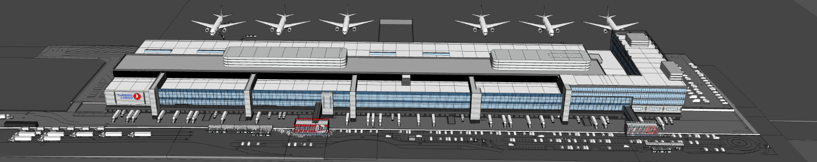

Istanbul New Aırport
Land Side
Parking Lot Enough for 25 Truck
90 Cargo Acceptance Door
Dedicated doors for Special Cargoes
Automatic Storage Systems
3 modules, 30 crane, 11 storey fast, unmanned storage system
200 position deteriorated cargo temperature controlled storage capacity
ULD acceptance operations from 11 different points
Fast and automated business processes with Comis integration
Storage Operation Areas
6600 sqm perishable cargo operation and storage
60.000 sqm general cargo operation
5.000 sqm mail and e-commerce operation
2.500 sqm courier operation
730 sqm Live Animal Center
900 sqm VAL Center
Notes:
Depo Operasyonları:
5.000 m2 bozulabilir kargo operasyon ve depolama alanı
3.000 m2 15/25 derece ısı kontrollü bozulabilir kargo operasyon alanı
2.000 m2 2/8 derece ısı kontrollü pharma kargo operasyon alanı
4 farklı ısı derecesine ait 1200 euro palet depolama kapasitesi
60.000 m2 genel kargo operasyon alanı
100 adet palet hazırlık ve bozum istasyonu
PCHS depolama sistemi ile entegre ULD hareketi
5.000 m2 posta ve e-ticaret operasyon alanı
2.500 m2 kurye operasyon alanı
480 m2 Live Animal Center
900 m2 VAL Center
Değerli kargo araçlarının operasyon alanına ulaşım sağlayacak altyapı

Slide 44





Awards
2014 India Cargo Airline of The Year
Stat Times
2014 Air Cargo News Cargo Airline of The Year
2015 Logitrans
International Air Cargo Winner
2015 Payload Asia
Combination Carrier of the Year
2016 Success in Logistics Awards
Logistics of the Year
2016 Logitrans
International Air Cargo Winner
2017 Payload Asia Overall Carrier of the Year Winner
2017 Stat Times International Award for Excellence in Air Cargo Winner
2018 ACW World Air Cargo Awards
Airline of the Year Winner
Notes:
And in this part let me give some examples from awards of Turkish Cargo. 2014 India Cargo Airline of The Year, Aircargonews Cargo Airline of The Year 2014, 2015 Logitrans International Air Cargo Winner, 2015 Payload Asia Combination Carrier of the Year, 2016 Succes in Logistics Awards Logistics of the Year.

Slide 45


